Slide 1
Failures of the EEC

Slide 2
Economic progress and the controversial CAP
Conditions for success seemed good in 1958. The economies of Western Europe were growing at a rate of 4.4 per cent a year, well above the world average, although since several non-EEC economies were also prospering, it is not certain to what extent early high growth rates in the Community were due to the existence of the EEC, or to other factors.
Agriculture was a contentious issue for the European Community. In 1958 it was still a major employer, accounting for 25 per cent of the French and 35 per cent of the Italian workforces. The French, Germans and Italians were very keen to protect their small farmers, even inefficient ones. The Dutch were more interested in modernising their farms and exporting produce.

Slide 3
The controversial Common Agricultural Policy (CAP) was launched in 1962. Prices of farm products were agreed and set at a level above world prices. If agreed targets were not met, the EC would buy up the surplus. This was an expensive policy: huge surplus stocks became embarrassments such as the 'butter mountain' and 'wine lake'; surpluses were wasted or sold off cheaply outside the Community. CAP did succeed in protecting farmers and ensuring Europe's self-sufficiency in food supplies. However, consumers paid high food prices, whilst the cost to the EC's budget was enormous. In the mid-1960s CAP accounted for about 17 per cent of the total EC budget. By 1972 this proportion had risen to a staggering 75 per cent, reducing the amount that the Community could allocate to other projects.

Slide 4
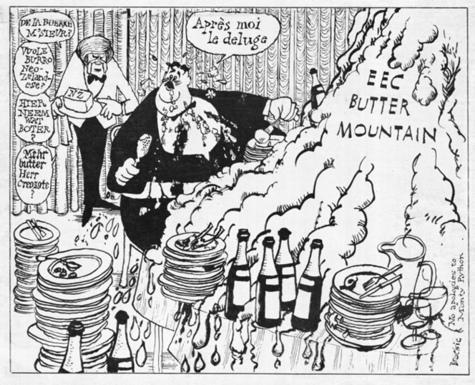

Slide 5
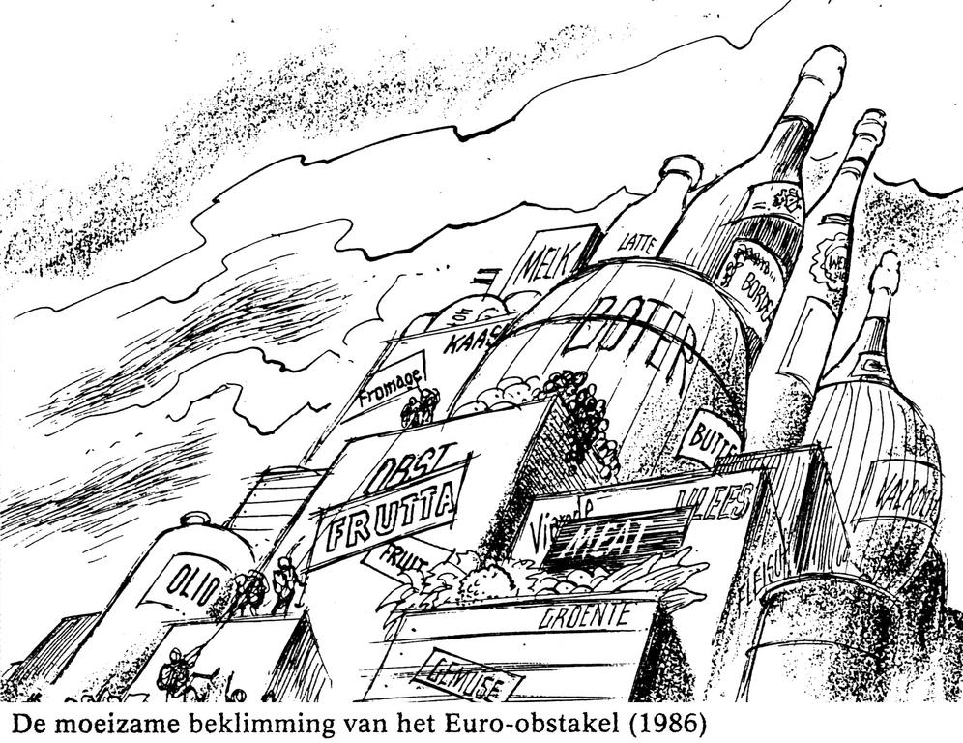

Slide 6
Currency Policy
After the 1973 oil crisis: currency fluctuations. That meant that imports were more expensive, because businesses had to build currency changes into the price of goods if they were exported or imported.
The EEC sought to create a common currency, but this failed because of severe economic problems of members
In 1972 the member states agreed a mechanism known as “the snake”, which aimed to keep the EEC currency fluctuations within 2%
That didn’t work after 1973 and the oil crisis. The snake was too rigid, so it was replaced with the Exchange Rate Mechanism (ERM) in 1979. In practice it meant that European currencies were bound to the German Deutschmark (the most powerful currency in the EC)

Slide 7
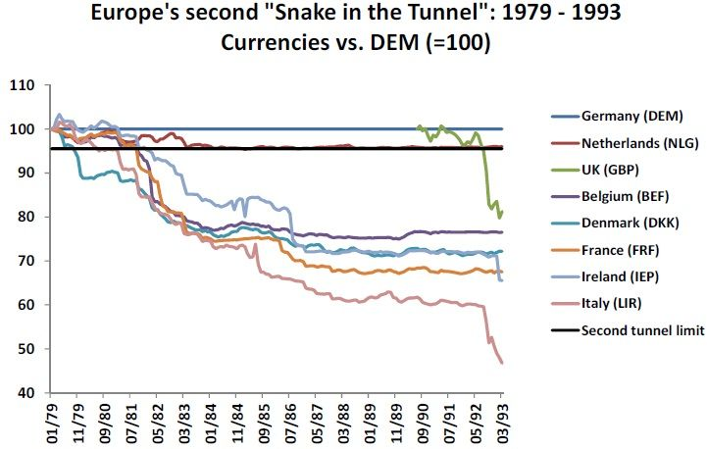

Slide 8
Trade policy
After 1973 there was pressure to protect local industries from foreign competition. Attempts of the Commission to deal with the problems that emerged were stopped by states who used their vetos.

